Slide 1
Yachting Victoria Annual General Meeting
September 18th 2017
Cherry Birch
President
Yachting Victoria Board

Slide 2
Annual General Meeting 2017
Welcome
Apologies
Minutes of previous meeting
Motion that the Minutes of the Half-Year General Meeting held on Monday 20th March 2017 be accepted.
4. Business Arising from the Minutes
5. President’s Report

Slide 3
One Sailing
One Year On!

Slide 4
Club Levies Working Party
Established by the Australian Sailing Board
Gary Langford, Chair (AS Director)
Reps from 5 MYA’s
Role
Determine a nationally consistent and equitable fee structure
Establish project time line
Agree methodology
Review existing fee setting
Make recommendations to Australian Sailing Board
Notes:
Issues
Different systems of calculating club fees
Banding systems are not uniform
Disparity of fees between clubs of similar size & capacity located in different states & territories
Clubs receive the same level of service
Revenue source is critical to underpin services and activities that support the growth and sustainability of sailing
Consider other sports- golf, rowing, cycling, bowls
Consider sailing in other countries- NZL, AN, USA, UK
Consider what we are doing now- Banding models seem to work- don’t penalise clubs for growing membership
Minimise admin for clubs and AS

Slide 5
Review of MYA Committees

Slide 6
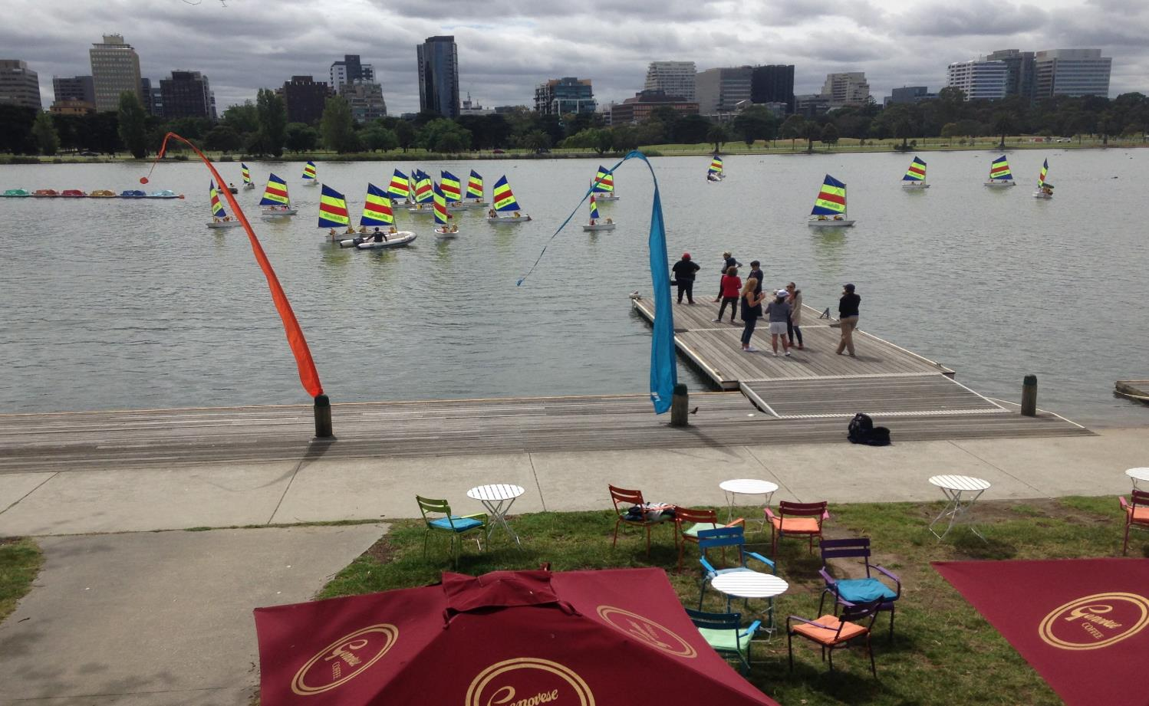
State Sailing Centre

Slide 7
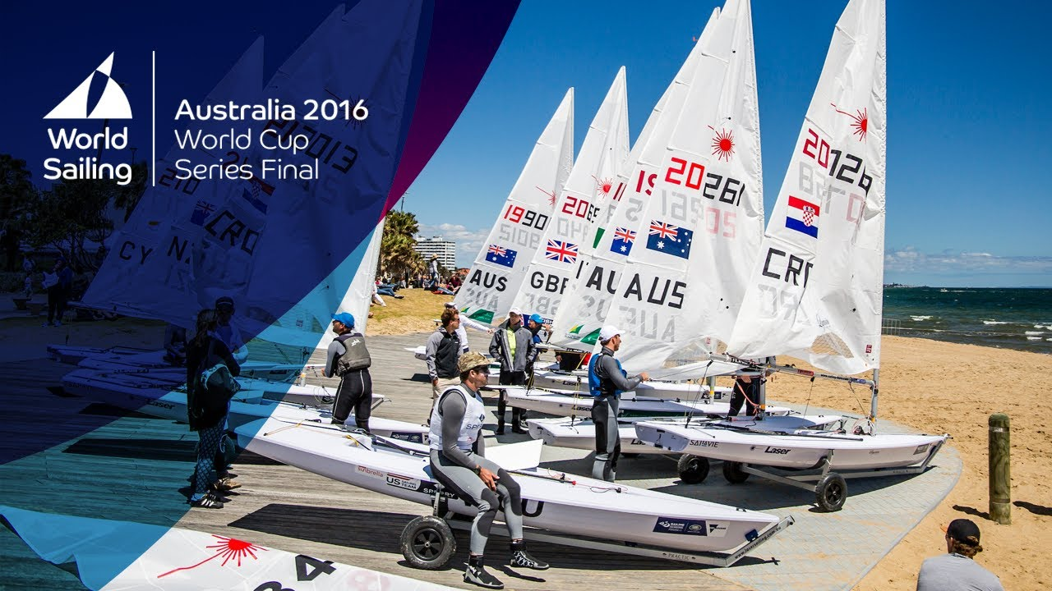

Slide 8
Sail Melbourne International

Slide 9
2020

Slide 10
Volvo Stop Over

Slide 11
Our YV Board and AS Staff

Slide 12
Annual General Meeting 2017
6. Treasurer’s Report – Ian Cunningham
Profit & Loss for Year Ended June 2017
Revenue | $
Events Income | 215,103
Sponsorship | 87,000
Grants | 596,499
Interest Income | 5,247
Other Income | 136,568
Total Revenue | 1,040,417
Expenses
Administration Costs | 747,059
Depreciation | 65,983
Total Expenses | 813,042
Current Year Profit/(Loss) | 227,375

Slide 13
Annual General Meeting 2017
Balance Sheet as at 30 June 2017
Assets | $
Cash At Bank | 672,056
Accounts Receivable | 141,360
Fixed Assets | 361,416
Total Assets | 1,174,832
Liabilities
Accounts Payable | 174,917
Deferred Income | 508,501
Total Liabilities | 683,418
Net Assets | 491,414
Current Year Earnings | 227,375
Retained Earnings | 264,039
Total Equity | 491,414

Slide 14
Annual General Meeting 2017
6. Treasurer’s Report – Ian Cunningham
Motion that the Financial statements for the year ended 30 June 2017
be adopted subject to an unqualified audit opinion being issued by Ernst & Young .

Slide 15
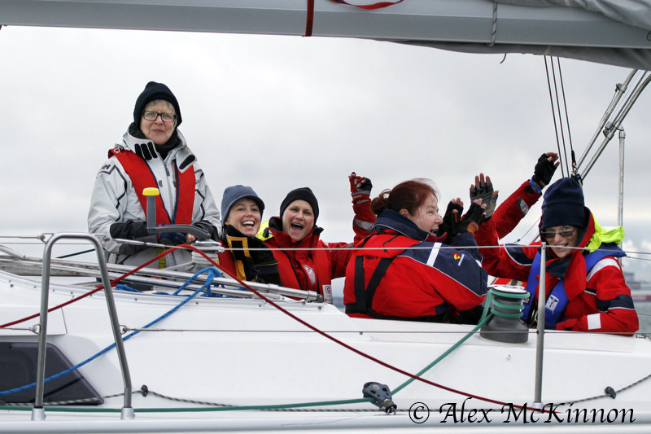
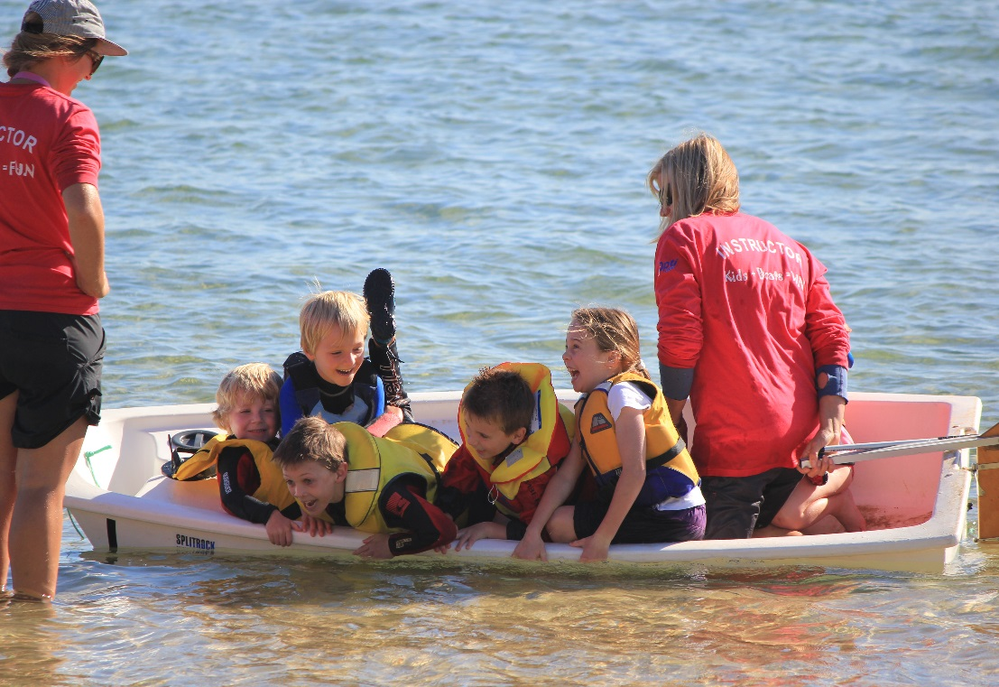
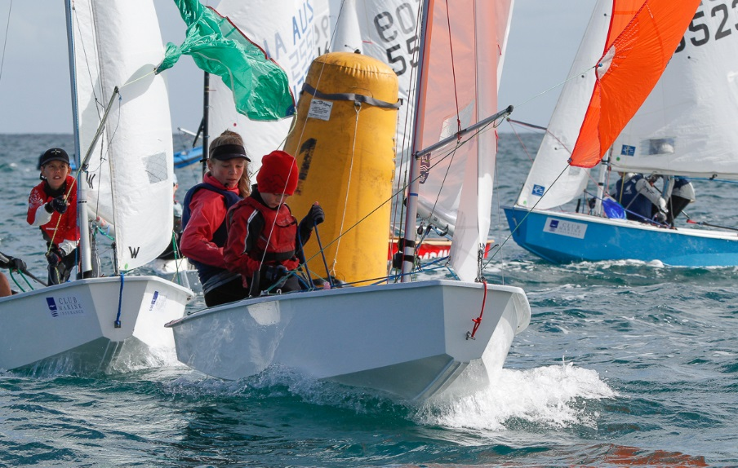
7. Australian Sailing – Victorian Report VIC - Club Membership
 |  |  | 2014-2015 |  | 2015-2016 |  | 2016-2017
TOTAL Adult - Vic |  | 19316 |  | 19767 |  | 20,631
TOTAL Youth - Vic |  | 3511 |  | 3791 |  | 4386
TOTAL Social - Vic |  | 1789 |  | 2034 |  | 2092
TOTAL Membership - Vic |  | 24616 |  | 25592 |  | 27109
Notes:
Great to see Victorian Club membership up again this year by approximately 6 %
Especially good to see our youth membership up by approx. 600 members
This is down to the hard work of you our member clubs and your :
The great collaboration I am seeing between our clubs, class associations and Australian Sailing
understanding that we need to adapt to the changing needs of the sporting public
While it is great to see membership growth for the 5th year in a row. There is still work to do. Unfortunately I still see clubs that are doing what they did 10, 15, 20 years ago and hope their membership will grow.

Slide 16
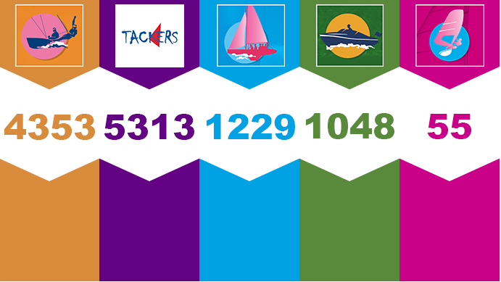
Victorian - Course Numbers
1594
2183
321
275

Slide 17
Child Safe Standards and Working with Children Checks

Slide 18
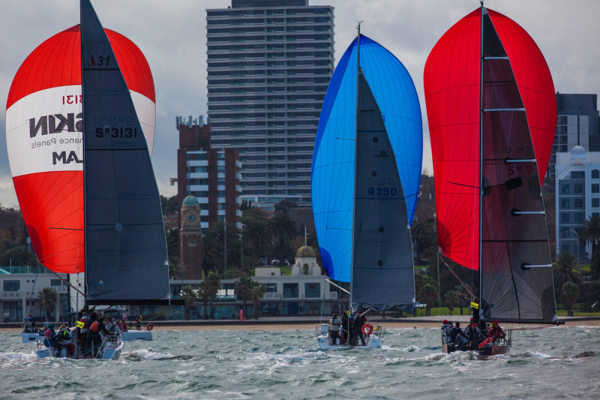
Ports and Marine Act Amendment

Slide 19
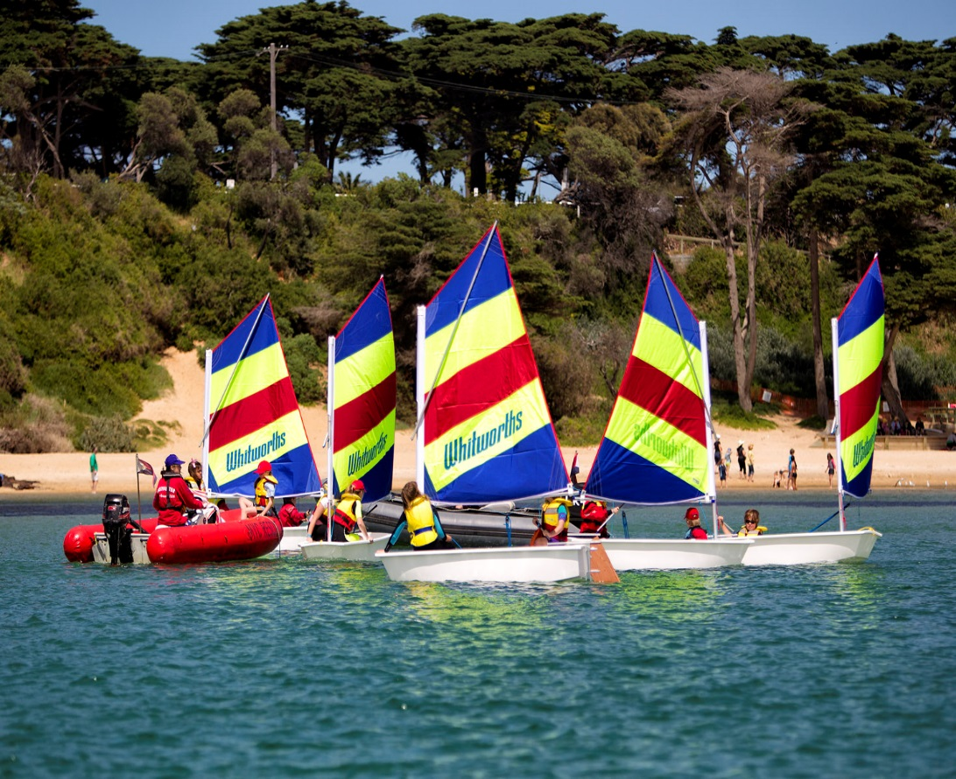
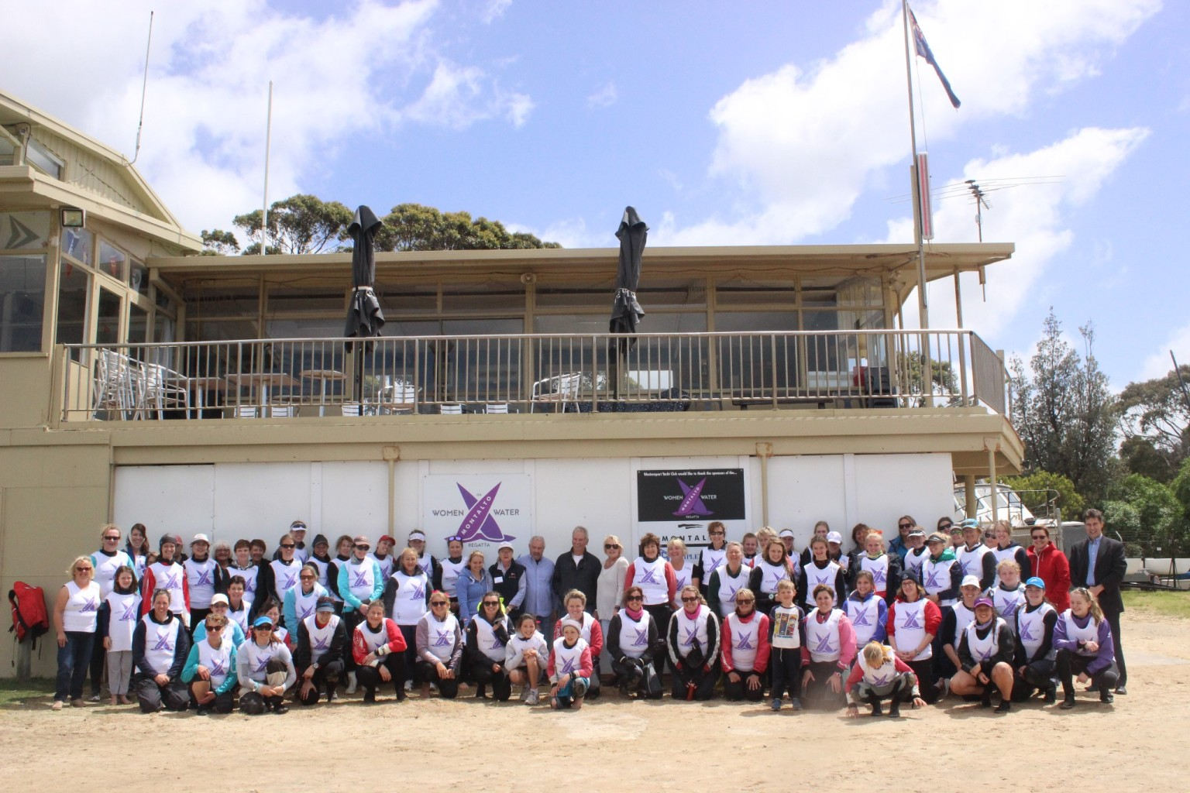
Victorian – Focus – 2017/2018
Tackers
Discover Sailing Programs
Green Fleet
Retention / Participation
Get Active Sailing
Flexible Membership options – Day Pass
Sporting Schools
Sailing Coach Course
Continued Female Participation & Leadership
Inclusion

Slide 20
Club Protected Weekends
Sailors to go back and support their clubs
No VST, PCP or class association training
Easier for clubs to run their club championship series and other special club events.
Minimise the number of club sailors absent due to other sailing events being held elsewhere.
Dates
September 30 / October 1
October 21 / 22
November 18 / 19
January 13 / 14
February 3 / 4
March 3 / 4
April 14 / 15 & 28 / 29
May 12 / 13 & 26 / 27
June 23 / 24

Slide 21
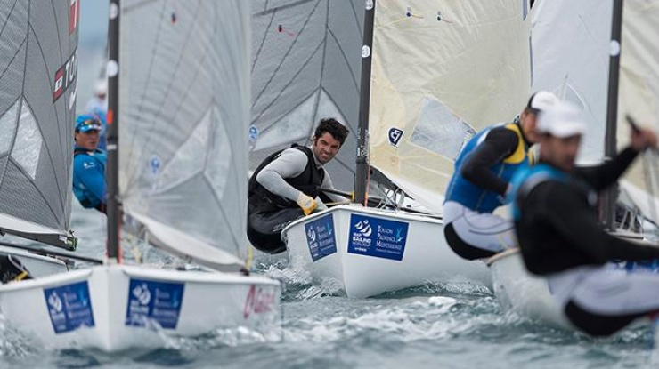
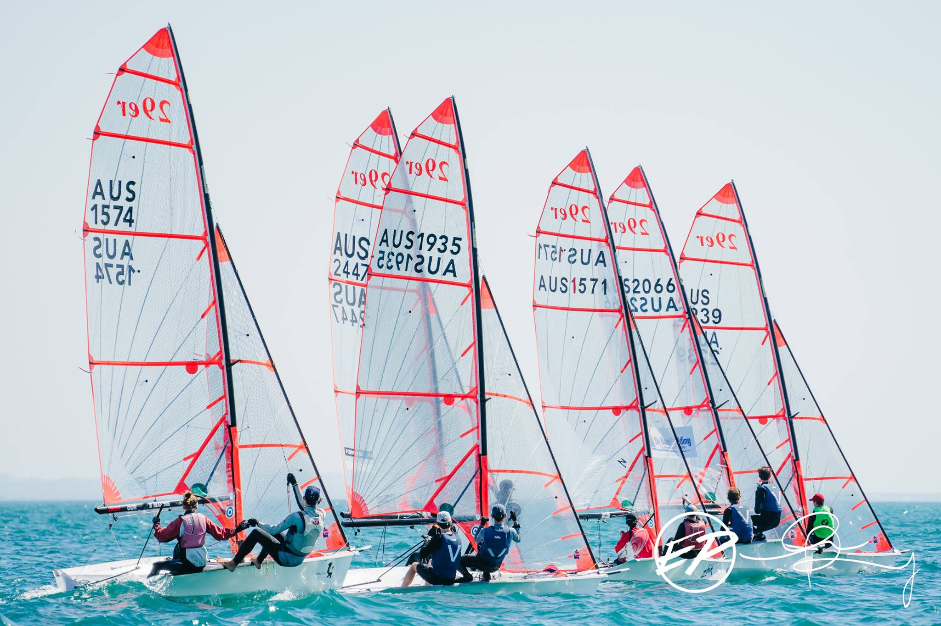
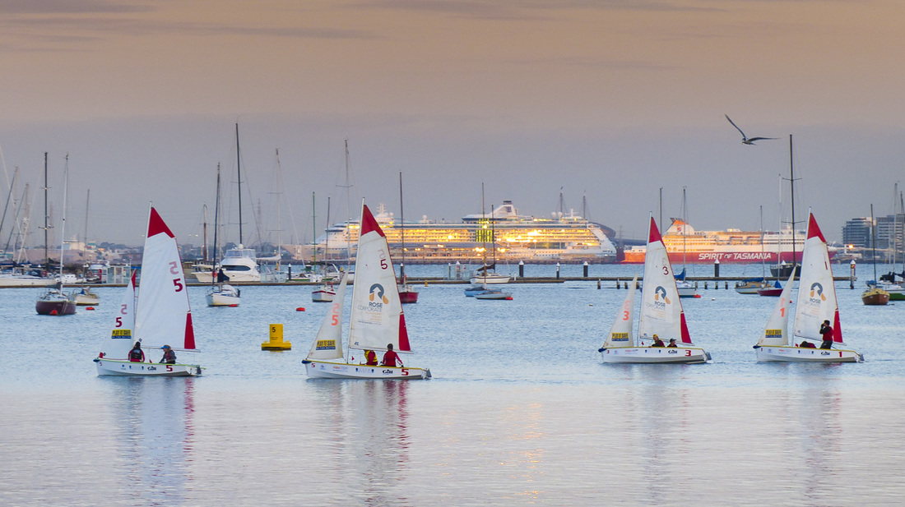
Victorian - Events
Discover Sailing Days: National Day 22 October, Victorian Days 12 November, 7 January – Any day that suits your club
Sail Melbourne International: 29 November to 3rd December
Nautilus Marine Series and PPWCS: 1st race October 14th hosted by RYCV
Victorian Junior Carnival: 10 February MYC
Victorian Youth Champs: April 18 @ SSCBC

Slide 22
Annual General Meeting 2017
8. Election of Board
Election of the Board Members for three (3) vacancies.
- Nomination for Liesl Petterd for Board Member – RYCV
- Nomination for Meaghan Densley for Board Member - FYC
Election of the President – Nomination for Cherry Birch - RMYS
Election of the Treasurer – Nomination for Ian Cunningham - McCYC
Election of Vice President – Board to appoint at a later date in accord with Rule 15 (8).

Slide 23
Annual General Meeting 2017
9. Appointment of Auditor & Honorary Solicitor
(a) Auditor
Motion that Ernst & Young be appointed as Auditors
(b) Honorary Solicitor
Motion that Vicki Bell be re-appointed Honorary Solicitor

Slide 24
Annual General Meeting 2017
10. General Business
11. Next Meeting
Half Year General Meeting – Monday 19 March 2018
Venue TBC

